Slide 1
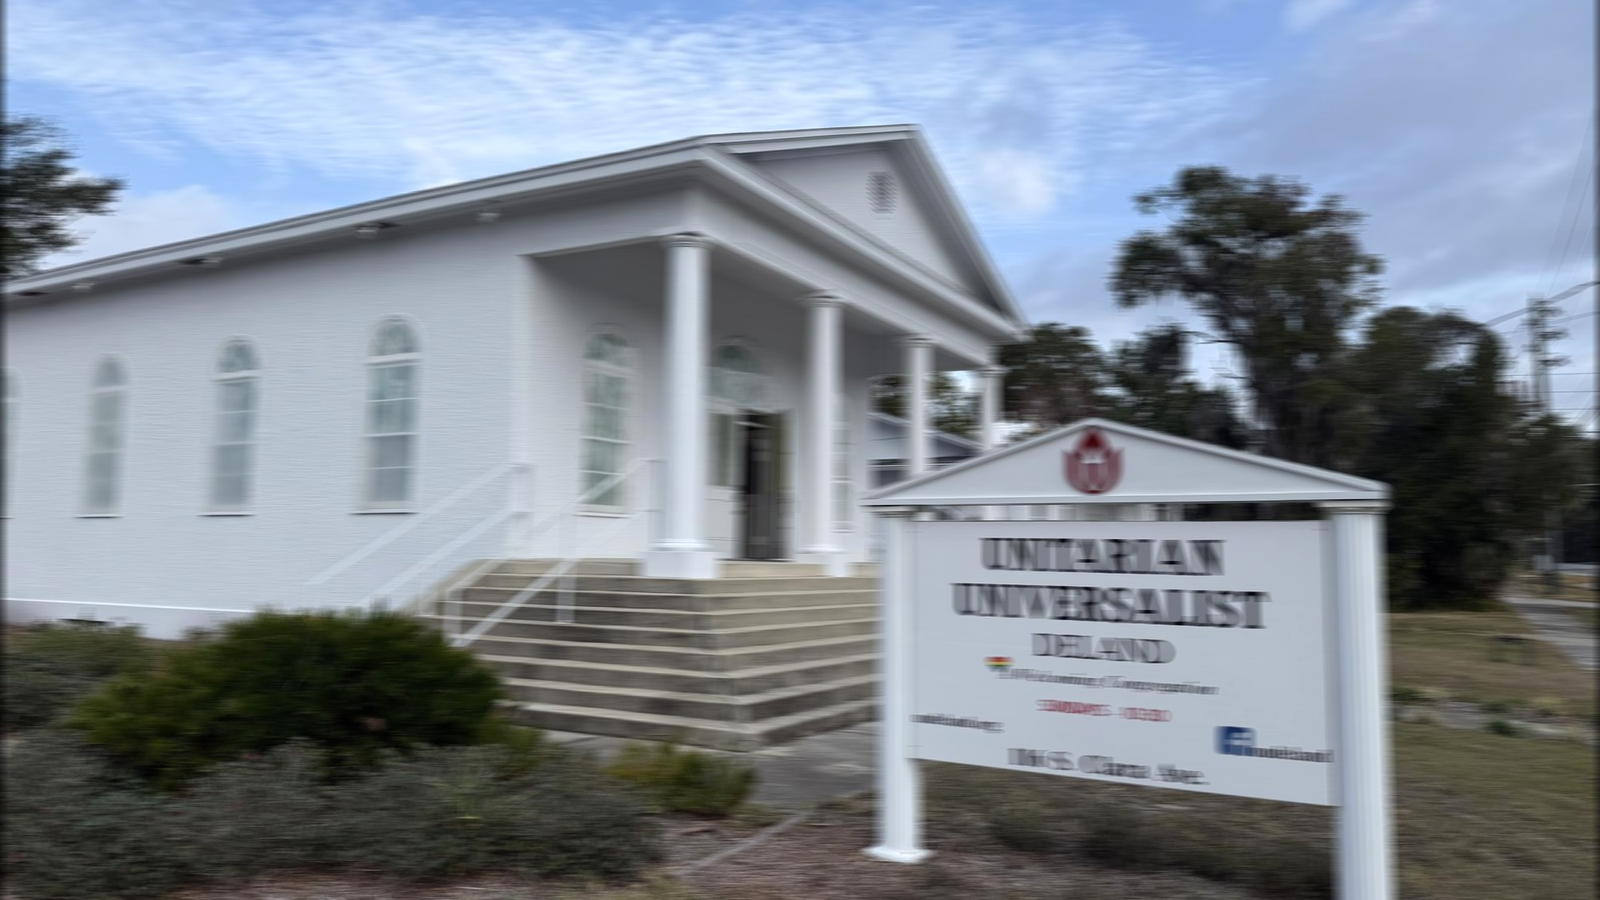
OUR CHALICE GLOWS
Notes:
Set 1, sign 1 of 5

Slide 2
OUR VALUES SOAR
Notes:
Set 1, sign 2 of 5

Slide 3
BUT KEEPING LIGHTS ON
Notes:
Set 1, sign 3 of 5

Slide 4
TAKES A LITTLE MORE
Notes:
Set 1, sign 4 of 5

Slide 5
Pledge Today
Notes:
Set 1, tagline sign (script)

Slide 6
SEVEN PRINCIPLES
Notes:
Set 2, sign 1 of 5

Slide 7
ONE FULL PLATE
Notes:
Set 2, sign 2 of 5

Slide 8
IF YOU HAVEN'T PLEDGED
Notes:
Set 2, sign 3 of 5

Slide 9
IT'S NOT TOO LATE
Notes:
Set 2, sign 4 of 5

Slide 10
UU DeLand
Notes:
Set 2, tagline sign (script)

Slide 11
WE WELCOME DOUBT
Notes:
Set 3, sign 1 of 5

Slide 12
WE WELCOME FAITH
Notes:
Set 3, sign 2 of 5

Slide 13
WE ALSO WELCOME
Notes:
Set 3, sign 3 of 5

Slide 14
YOUR GENEROUS STAKE
Notes:
Set 3, sign 4 of 5

Slide 15
Pledge Sunday
Notes:
Set 3, tagline sign (script)

Slide 16
NO CREED TO SIGN
Notes:
Set 4, sign 1 of 5

Slide 17
NO DOGMA'S BINDING
Notes:
Set 4, sign 2 of 5

Slide 18
JUST A BUDGET GAP
Notes:
Set 4, sign 3 of 5

Slide 19
THAT NEEDS SOME FINDING
Notes:
Set 4, sign 4 of 5

Slide 20
Give Today
Notes:
Set 4, tagline sign (script)

Slide 21
SPIRIT FREE
Notes:
Set 5, sign 1 of 5

Slide 22
MIND WIDE OPEN
Notes:
Set 5, sign 2 of 5

Slide 23
BUT THE FURNACE BILL
Notes:
Set 5, sign 3 of 5

Slide 24
STILL NEEDS A TOKEN
Notes:
Set 5, sign 4 of 5

Slide 25
Pledge Now
Notes:
Set 5, tagline sign (script)

Slide 26
LOVE IS THE DOCTRINE
Notes:
Set 6, sign 1 of 5

Slide 27
THIS CHURCH DOTH TEACH
Notes:
Set 6, sign 2 of 5

Slide 28
SO IS A PLEDGE CARD
Notes:
Set 6, sign 3 of 5

Slide 29
WELL WITHIN YOUR REACH
Notes:
Set 6, sign 4 of 5

Slide 30
UU DeLand
Notes:
Set 6, tagline sign (script)

Slide 31
UUDELAND.ORG
First Unitarian Universalist Church of West Volusia
Notes:
Closing signature sign before the loop restarts

