Slide 1

Living the Scout
Oath and Law:
A UU Perspective
Presented by John Cupak
Notes:
Speaker Notes: Welcome and thank you for joining me today. I’m honored to share insights on how the 12 points of the Scout Law align beautifully with the values of our Unitarian Universalist faith.

Slide 2
Introduction
Introduce the Scout Oath and Law
Explore its resonance with UU principles
Foster reflection on shared moral values
Notes:
Speaker Notes: The Scout Law serves as a moral compass for Scouts. Today, we’ll explore how its values echo our own UU commitments to justice, compassion, and community.

Slide 3

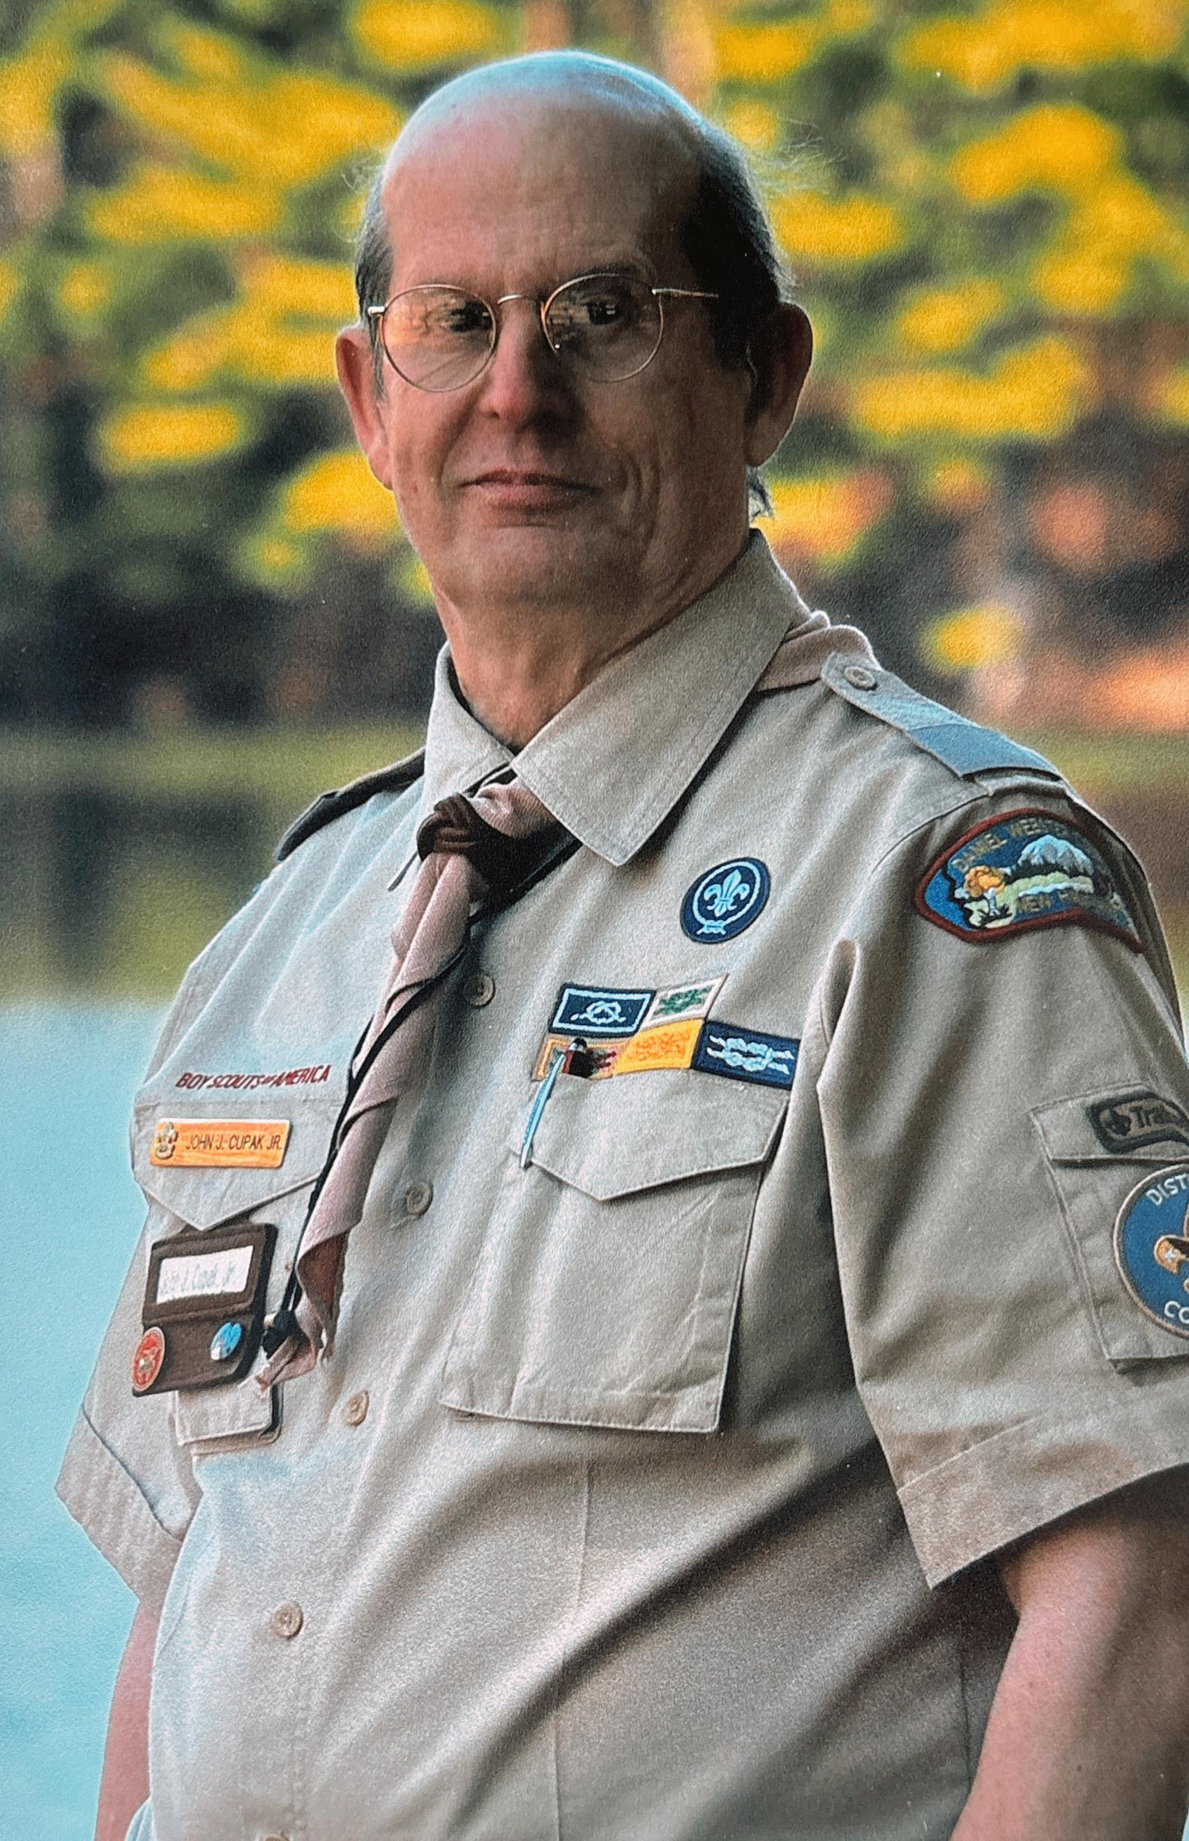

About Me
Cub Scout, Boy Scout, & Explorer
Adult Scouter – Trained & Experienced
UU for 40 years
UU Deland Member
Notes:
Speaker Notes: The Scout Law serves as a moral compass for Scouts. Today, we’ll explore how its values echo our own UU commitments to justice, compassion, and community.

Slide 4

THE SCOUT OATH
On my honor I will do my best
To do my duty to God and my country
and to obey the Scout Law;
To help other people at all times;
To keep myself physically strong,
mentally awake, and morally straight.

Slide 5
Duty to God
Scout Oath: Duty to God
UU: Free and responsible search for truth and meaning
UU: Respect for the interdependent web of existence
Common Ground: Moral grounding and spiritual accountability

Slide 6
Duty to Country
Scout Oath: Duty to country
UU: Democratic process and right of conscience
UU: Goal of world community with justice and peace
Common Ground: Ethical citizenship and civic responsibility

Slide 7
Scout Law and UU Ethics
Scout Law: Trustworthy, Loyal, Helpful, Kind, Brave, etc.
UU: Inherent worth and dignity of every person
UU: Justice, equity, and compassion in human relations
Common Ground: Character formation and moral development

Slide 8
Helping Other People at All Times
Scout Oath: Daily acts of service
UU: Justice, compassion, and social responsibility
Common Ground: Service as a way of life

Slide 9
Personal Growth and Discipline
Scout Oath: Physically strong, mentally awake, morally straight
UU: Responsible search for truth and meaning
Common Ground: Lifelong growth of body, mind, and character

Slide 10
Key Distinction
Scouting: Values-based youth development program
Unitarian Universalism: Covenant-based religious tradition
Shared Emphases: Integrity, Service, Community, Ethical Living

Slide 11
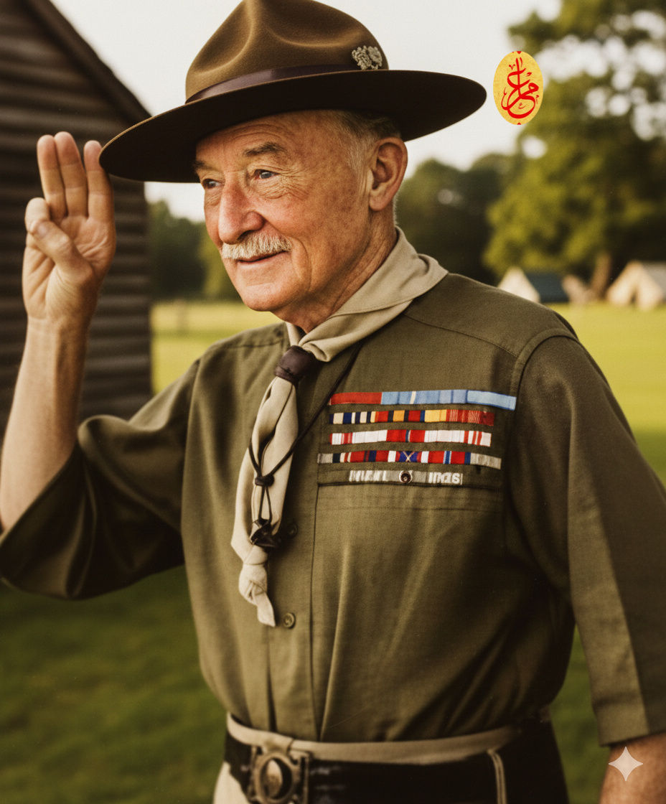
The Scout Law
"The Scout Law was not framed as a list of prohibitions; for prohibition generally invites evasion, since it challenges the spirit in every red-blooded boy.
A boy is not governed by 'don'ts,' but is led by what he should do.”
Lessons from the Varsity of Life
Lord Baden-Powell

Slide 12
The Scout Law - Overview
A Scout is:
Trustworthy
Loyal
Helpful
Friendly
Courteous
Kind
Obedient
Cheerful
Thrifty
Brave
Clean
Reverent
Notes:
Speaker Notes: These twelve traits define what it means to be a Scout. They’re not just aspirations but expectations—ideals we strive to live by every day.

Slide 13
Trustworthy
Honest, keeps promises
UU Connection: 1st Principle – Inherent worth and dignity of every person
Example: Being reliable in group ministry work
Notes:
Speaker Notes: Trust begins with honesty. As UUs, we trust each other to speak our truth and honor our commitments. Scouts do the same.

Slide 14
Loyal
Faithful to family, friends, nation
UU Connection: Covenant and community
Example: Standing by fellow congregants in need
Notes:
Speaker Notes: Loyalty builds relationships. UUs are bound by covenant, not creed—just as Scouts are loyal not only to their troop, but to ideals.

Slide 15
Helpful
Volunteers without being asked
UU Connection: Justice, equity, compassion in human relations
Example: Participating in service projects
Notes:
Speaker Notes: Helping isn’t just an act—it’s a practice of justice. When Scouts serve, they live out compassion, just like we do through social action.

Slide 16
Friendly
A friend to all
UU Connection: Acceptance of one another
Example: Welcoming newcomers to the congregation
Notes:
Speaker Notes: Friendliness opens doors to inclusion. Scouts strive to be a friend to everyone, just as we seek to build a welcoming, diverse community.

Slide 17
Courteous
Polite and respectful
UU Connection: Respect for all beings
Example: Listening during meetings with humility
Notes:
Speaker Notes: Courtesy is a form of respect. UUs and Scouts both honor the dignity in others through our words and actions.

Slide 18
Kind
Compassionate and caring
UU Connection: 2nd Principle – Justice, equity, compassion
Example: Supporting someone in crisis
Notes:
Speaker Notes: Kindness is love in action. Both traditions teach us to respond to suffering with empathy and support.

Slide 19
Obedient
Follows rules and laws
UU Connection: Right use of conscience and shared responsibility
Example: Abiding by community agreements
Notes:
Speaker Notes: Obedience in Scouting is about responsibility and integrity. In UU spaces, we follow our covenants and respect collective wisdom.

Slide 20
Cheerful
Maintains a positive attitude
UU Connection: Celebration of life’s gifts
Example: Encouraging spirit during challenges
Notes:
Speaker Notes: Cheerfulness is contagious. Both Scouts and UUs uplift one another, finding joy even in service and difficulty.

Slide 21
Thrifty
Uses resources wisely
UU Connection: Stewardship and environmental justice
Example: Practicing sustainability at church events
Notes:
Speaker Notes: Thrift is about mindful living. We share a duty to care for our Earth and use resources with respect and gratitude.

Slide 22
Brave
Faces fears with courage
UU Connection: Pursuit of truth and justice
Example: Speaking up against injustice
Notes:
Speaker Notes: Bravery is more than boldness—it’s moral courage. UUs and Scouts both stand up for what’s right, even when it’s hard.

Slide 23
Clean
Pure in body, mind, and speech
UU Connection: Commitment to ethical living
Example: Keeping spaces and relationships healthy
Notes:
Speaker Notes: Cleanliness includes clarity and care in all we do. It invites mindfulness and self-respect.

Slide 24
Reverent
Respectful toward spiritual beliefs
UU Connection: Direct experience of transcending mystery
Example: Participating in interfaith services with respect
Notes:
Speaker Notes: Reverence honors the mystery and wonder in life. In both Scouting and UU traditions, we respect all spiritual paths.

Slide 25
Reflection
Which Scout Law point speaks to you?
How do you live UU values daily?
What lessons do you want to pass on?
Notes:
Speaker Notes: Use these questions for your own reflection or a group discussion. They help us turn values into action.

Slide 26
Let us be trustworthy, loyal, helpful, friendly, courteous, kind, obedient, cheerful, thrifty, brave, clean, and reverent
together.

Slide 27
THANK YOU!
Any questions?
You can find me at
john.cupak@me.com
Notes:
Speaker Notes: Thank you for this opportunity to share. May we continue to live our values with purpose, courage, and compassion.

Slide 28
ISSUES

Slide 29
Youth Safety & Protection
Mandatory background checks for all adult leaders
Two-deep leadership and no one-on-one contact policies
Required Youth Protection Training with regular renewals
Clear reporting and accountability procedures
Notes:
Youth Safety & Protection
Issue:
Concerns about child safety, abuse prevention, and adult supervision.
Solution:
Mandatory background checks for all adult leaders
Two-deep leadership and no one-on-one contact policies
Required Youth Protection Training with regular renewals
Clear reporting and accountability procedures

Slide 30
Cost & Accessibility
Local and national financial assistance programs
Unit-level fundraising to offset costs
Shared uniforms and gear libraries
Flexible participation options to reduce barriers
Notes:
Cost & Accessibility
Issue:
Perception that Scouting is too expensive or inaccessible for some families.
Solution:
Local and national financial assistance programs
Unit-level fundraising to offset costs
Shared uniforms and gear libraries
Flexible participation options to reduce barriers

Slide 31
Relevance in Today’s World
STEM, leadership, and career-focused programs
Outdoor skills balanced with technology and innovation
Emphasis on real-world life skills and service learning
Youth-led activities tailored to current interests
Notes:
Relevance in Today’s World
Issue:
Concerns that Scouting is outdated or doesn’t align with modern interests.
Solution:
STEM, leadership, and career-focused programs
Outdoor skills balanced with technology and innovation
Emphasis on real-world life skills and service learning
Youth-led activities tailored to current interests

Slide 32
Inclusivity & Belonging
Open membership policies
Respect for diverse backgrounds and beliefs
Training for leaders on inclusion and belonging
Programs designed to welcome every youth
Notes:
Inclusivity & Belonging
Issue:
Questions about diversity, inclusion, and who Scouting is for.
Solution:
Open membership policies
Respect for diverse backgrounds and beliefs
Training for leaders on inclusion and belonging
Programs designed to welcome every youth

Slide 33
Program Quality & Leader Support
Structured leader training and ongoing support
Nationally tested program framework
Mentorship and shared best practices across units
Continuous evaluation and improvement
Notes:
Program Quality & Leader Support
Issue:
Inconsistent program quality and concerns about leader preparedness.
Solution:
Structured leader training and ongoing support
Nationally tested program framework
Mentorship and shared best practices across units
Continuous evaluation and improvement

Slide 34
LGBTQ+ Inclusion in Scouting
Scouting affirms the inherent worth and dignity of every person
Sexual orientation or identity does not determine leadership suitability
Clear standards of conduct apply equally to all adults and youth
Strong Youth Protection policies ensure safety, accountability, and trust
Units are encouraged to cultivate respect, compassion, and belonging
Notes:
Slide: LGBTQ+ Inclusion in Scouting
Issue:
Questions about how Scouting affirms LGBTQ+ youth and adult leaders while maintaining a safe, values-based program.
This issue was one of the deciding factors in the loss of Latter-Day Saints support for Scouting
Approach:
Scouting affirms the inherent worth and dignity of every person
Sexual orientation or identity does not determine leadership suitability
Clear standards of conduct apply equally to all adults and youth
Strong Youth Protection policies ensure safety, accountability, and trust
Units are encouraged to cultivate respect, compassion, and belonging

Slide 35
Girls as Scouts
Girls have full access to leadership development, outdoor adventure, and advancement
Program options allow for single-gender or linked units based on family preference
The core Scouting experience remains youth-led and mission-focused
Inclusion strengthens character development and broadens perspectives
Notes:
Slide: Girls as Scouts
Issue:
Concerns about how welcoming girls into Scouting impacts tradition and program integrity.
Approach:
Girls have full access to leadership development, outdoor adventure, and advancement
Program options allow for single-gender or linked units based on family preference
The core Scouting experience remains youth-led and mission-focused
Inclusion strengthens character development and broadens perspectives

Slide 36
Women as Adult Leaders
Women meet the same training, safety, and leadership standards as all adults
Female leadership is required for activities involving girls
Diverse leadership models reflect equity and shared responsibility
Expanded leadership enhances mentorship, safety, and community strength
Notes:
Women as Adult Leaders
Issue:
Questions about preparedness, outdoor leadership, and changing leadership dynamics.
Approach:
Women meet the same training, safety, and leadership standards as all adults
Female leadership is required for activities involving girls
Diverse leadership models reflect equity and shared responsibility
Expanded leadership enhances mentorship, safety, and community strength

Slide 37
Staying Grounded in the Mission
The mission remains focused on character, leadership, and service
Inclusion reinforces empathy, justice, and ethical growth
Outdoor skills, community service, and youth leadership remain central
Success is measured by the growth and well-being of young people
Notes:
Slide: Staying Grounded in the Mission
Issue:
Concern that conversations around gender or identity may overshadow Scouting’s purpose.
Approach:
The mission remains focused on character, leadership, and service
Inclusion reinforces empathy, justice, and ethical growth
Outdoor skills, community service, and youth leadership remain central
Success is measured by the growth and well-being of young people

Slide 38
UU Award - Religion in Life
Purpose
To help Unitarian Universalist young people learn about our faith: our beliefs, our history, our denominational structure, and how we live in the world
To support Unitarian Universalist youth as they live their faith
To provide a program for Unitarian Universalists that can lead to the awarding of the Religion in Life emblem for Scouts BSA
To recognize the achievements of youth in Unitarian Universalist congregations

Slide 39
What Can We Learn from Each Other?
Encourage collaboration
Suggest joint projects or reflections
Notes:
Speaker Notes: We each have much to give—and even more to learn. Let’s explore ways to grow together in service, learning, and love.

